Slide 1


Introduction to Machine Learning and Proteomics for Diagnosis and Prognosis of Diseases
Lucas Cardoso Lázari
Glycoproteomics Lab

Slide 2
Disease Biomarkers and Proteomics
What is a Biomarker?
“A defined characteristic that is measured as an indicator of normal biological processes, pathogenic processes or responses to an exposure or intervention.”
FDA-NIH Biomarker Working Group. BEST (Biomarkers, EndpointS, and other Tools) Resource. Silver Spring (MD): Food and Drug Administration (US); Bethesda (MD): National Institutes of Health (US).
For clinical purposes, the main objective of a biomarker is to evaluate the health state of an individual, for diagnosis, preventive treatment and/or treatment efficacy if a disease has been diagnosed. (needs to be sensitive and specific enough to be used in laboratory tests)
Biomarkers as indicatives: They provide enough information about the health state, but they don’t necessary meet the criteria of diagnostic specificity and sensitivity.

Slide 3
Disease Biomarkers and Proteomics
It is possible to find a specific biomarker for a certain disease. But the reality is that a biomarker may be an indicative of many dieases:
Prostate-Specific Antigen (PSA): Prostate Cancer, Benign Prostatic Hyperplasia, Prostatitis
Troponin: Myocardial Infarction, Myocarditis, Pulmonary Embolism, Chronic Kidney Disease
Hemoglobin A1c (HbA1c): Diabetes Mellitus, Anemia
Alpha-fetoprotein (AFP): Liver Cancer, Germ Cell Tumors, Hepatitis, Cirrhosis
B-type natriuretic peptide (BNP) and N-terminal pro b-type natriuretic peptide (NT-proBNP): Heart Failure, Pulmonary Hypertension, Left Ventricular Hypertrophy, Acute Kidney Injury
CA-125: Ovarian Cancer, Endometriosis, Pelvic Inflammatory Disease, Menstruation, Pregnancy
Amyloid beta (Aβ) and Tau proteins: Alzheimer's Disease, Other Neurodegenerative Disorders
C-reactive protein (CRP): Inflammation, Cardiovascular Disease, Infection, Rheumatoid Arthritis, Lupus
Erythrocyte sedimentation rate (ESR): Inflammatory Conditions, Rheumatoid Arthritis, Temporal Arteritis, Polymyalgia Rheumatica
Colorectal cancer
Carcinoembryonic antigen (CEA)
Ovarian
cancer
Breast
cancer
One biomarker can be present in many types of cancer.
What if we use multiple proteins for diagnosis/prognosis?

Slide 4

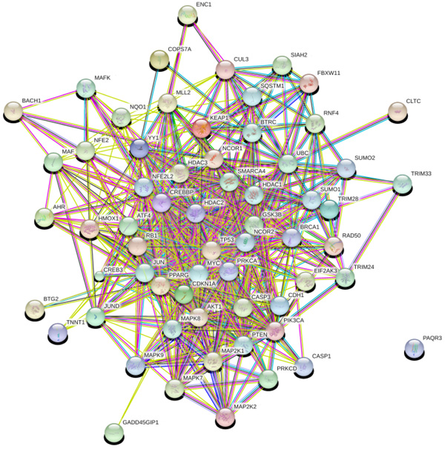
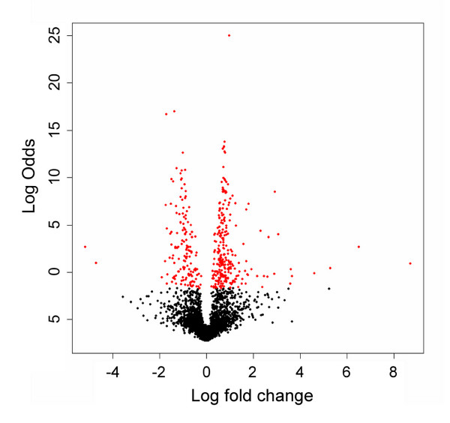
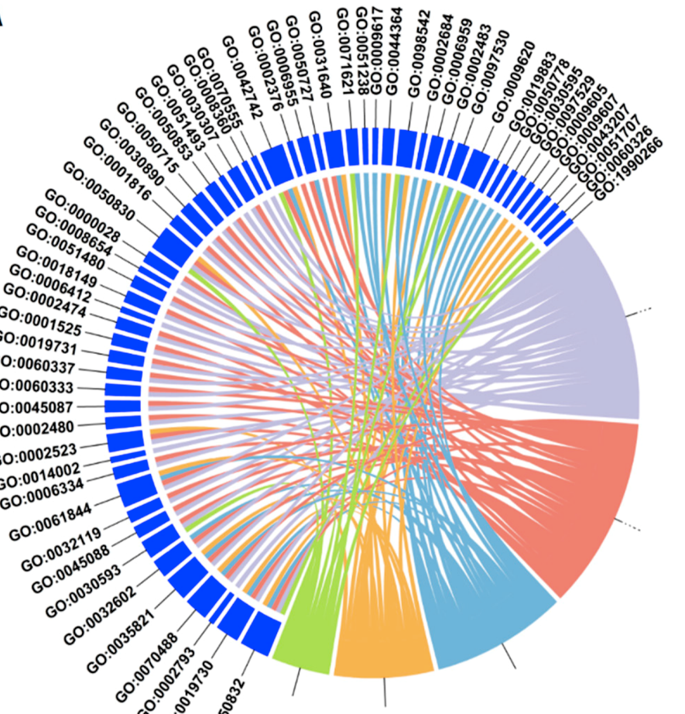
Disease Biomarkers and Proteomics
Group A
Group B
If one biomarker is not specifc to detect and track a certain disease, we could use multiple biomarkers to perform this task;
However, creating a device that is able to keep track of multiple proteins is extremely difficult, and potentially very expensive;
So the main question is:
Proteomics
How can we measure multiple proteins at once and use this information for diagnosis/prognosis purposes while keeping it relatively fast, low-cost and accurate?
Alterations at protein level can indicate differences between groups

Slide 5
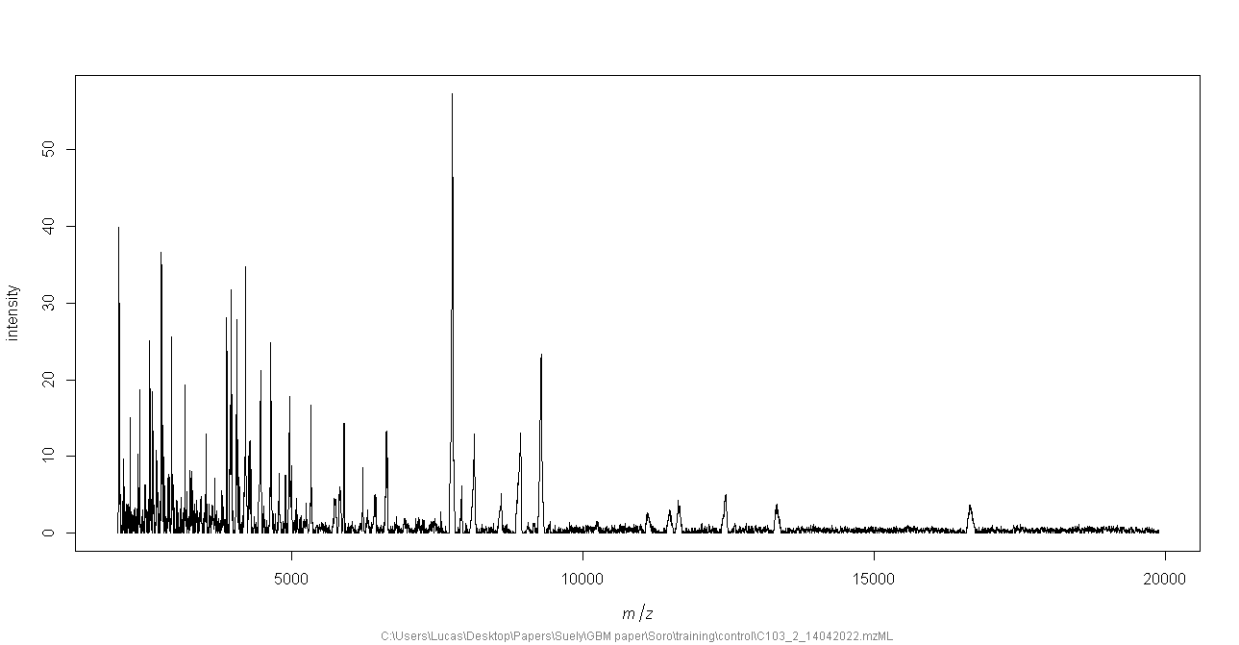
MALDI-TOF MS for protein profiling
Protein identification require sample preparation protocols that are time-consuming and expensive;
With MALDI-TOF MS we can use simple sample preparation protocols, that allows us to prepare hundreds of samples relatively faster and cheaper;
Protein identification is not required since we will use the protein profile to train classification models for diagnosis/prognosis of diseases.
The spectrum obtained from MALDI-TOF MS does not provides us much information, but provide enough to train machine learning models;
They will learn the patters in the spectrum and differentiate groups based in this information.

Slide 6

What is machine learning?
Machine learning is a subfield of artificial intelligence (AI) that focuses on the development of algorithms and models that enable computers to learn and make predictions or decisions without being explicitly programmed.
The fundamental concept behind machine learning is to enable computers to learn from examples or experiences and improve their performance over time.
By iteratively analyzing and processing the data, these algorithms can identify patterns, correlations, and underlying structures, and use this knowledge to make predictions or take actions on new, unseen data.

Slide 7
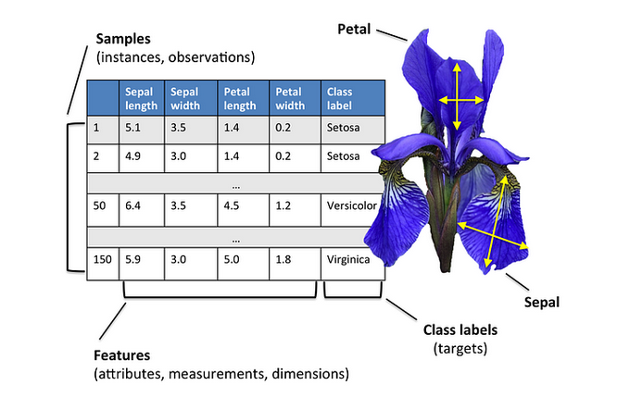
What is machine learning?
There are many models: Linear Regression, Decision Trees, Support Vector Machines, Neural Networks, Random Forests, Gradient Boosting Machines, and many more.
Each of these models use different strategies to learn from data;
But in simple terms, the look at the features and learn the patterns that are characteristics of each class.
Raschka, S. (2015). PCA in 3 steps. Retrieved on October 18, 2023, at 20:00, from ttps://sebastianraschka.com/Articles/2015_pca_in_3_steps.html

Slide 8
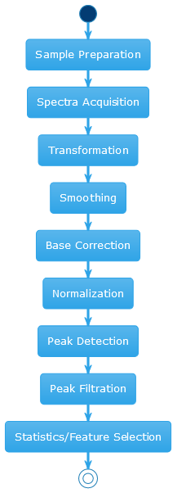
Application of machine learning in MALDI-TOF data
The first step is to create the features;
A feature is considered a measurable property of characteristic of your data, in our case, the proteins;
However, since we don’t identify the proteins, all we have are peaks in certain mass/charge ratios that corresponds to proteins that we don’t know;
Then, we must process this data, performing corrections in the spectra, normalizing the intensities and separating what is noise and what is a protein peak.

Slide 9
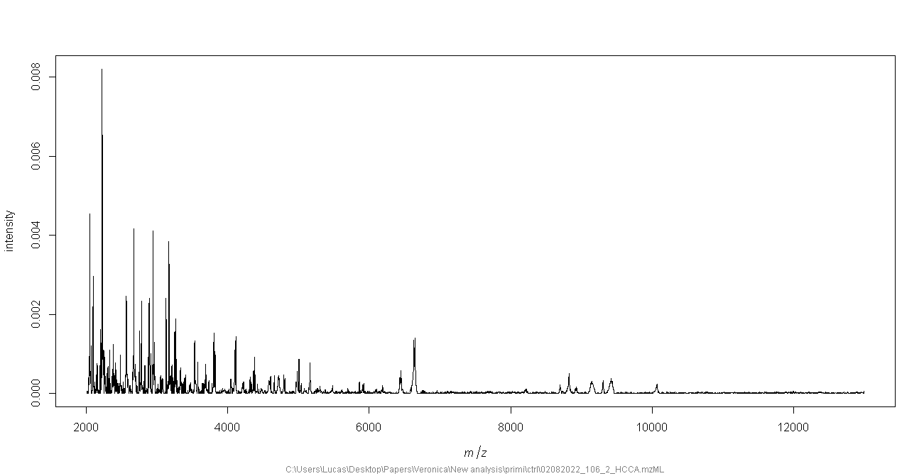
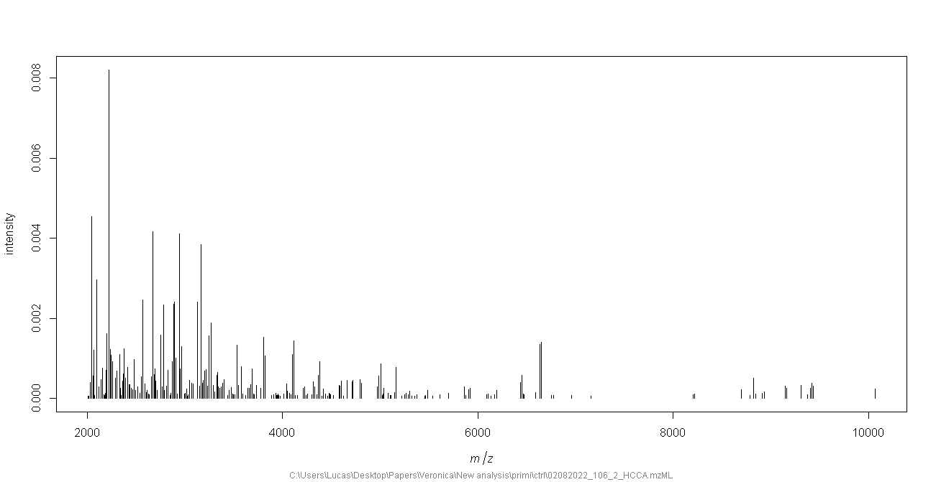
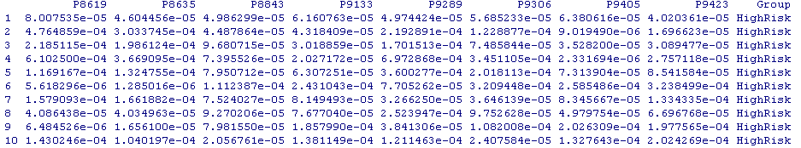
Application of machine learning in MALDI-TOF data
Data processing
Training models

Slide 10
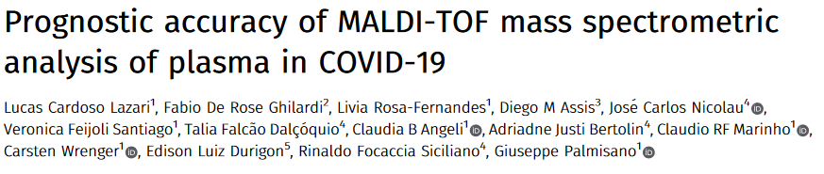
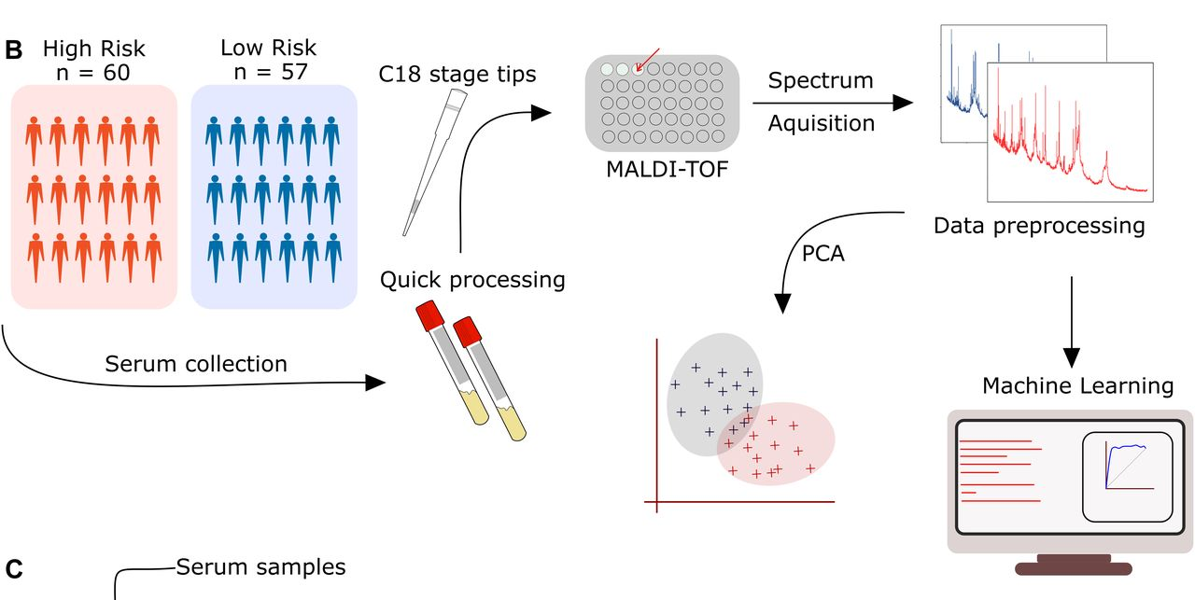
Example on COVID-19 data
The objective was to predict if a patient would have high risk or low risk for hospitalization

Slide 11
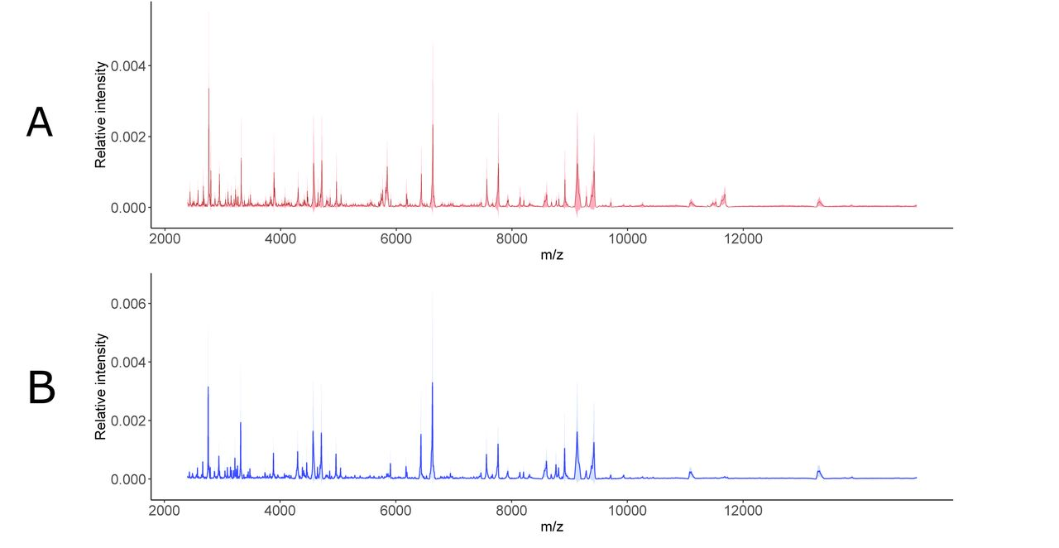
Example on COVID-19 data
High Risk
It is diffictult to see meaningfull diferences with naked eye, but a machine learning model can find the most important protein peaks and classify the groups.
Low Risk

Slide 12
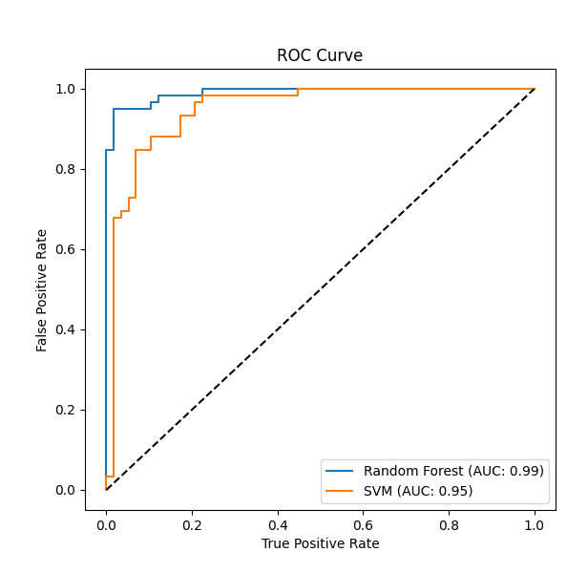
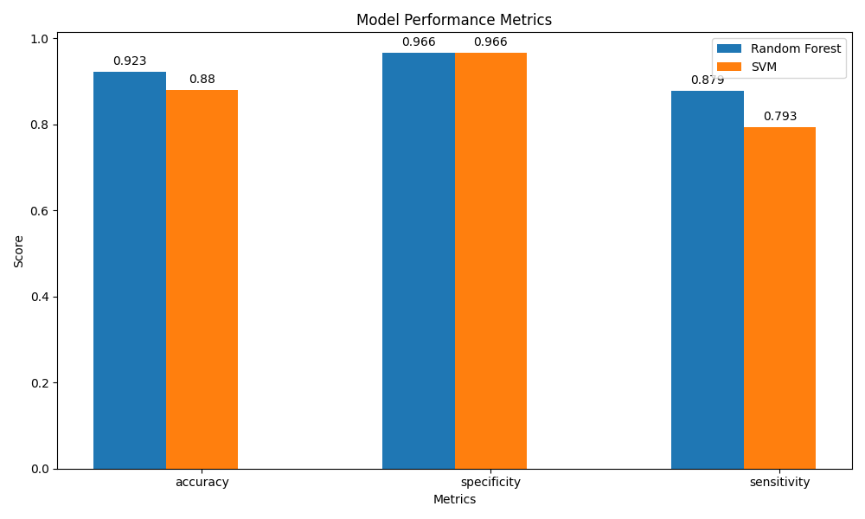
Example on COVID-19 data
The ROC curve and its AUC are used to assess the performance of classification models, especially in cases where the class distribution is imbalanced. It provides insights into the trade-offs between sensitivity and specificity at different threshold settings, allowing decision-makers to select an optimal threshold based on their specific needs or priorities.

Slide 13
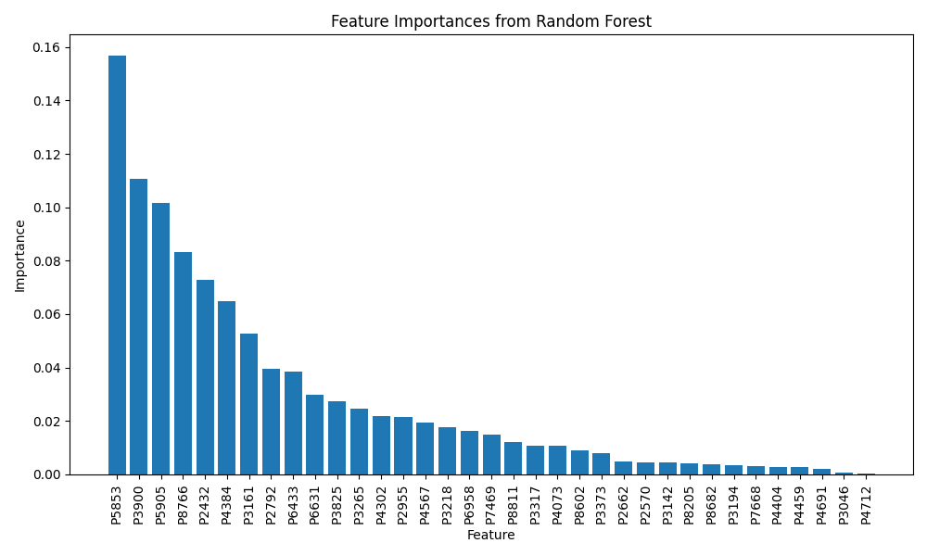
Example on COVID-19 data
Some models are interpretable. Random forest for example can provide to us the most important features for sample classification. This can assist us in the discovery of possible biomarkers;
The top 3 m/z are: 5853, 3900, 5905.

Slide 14
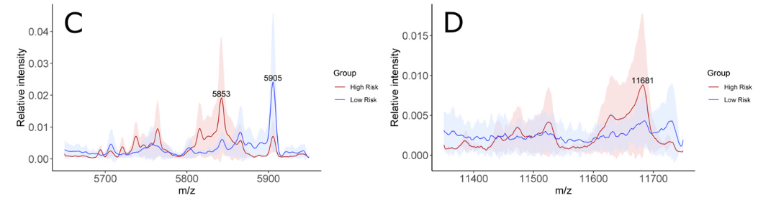
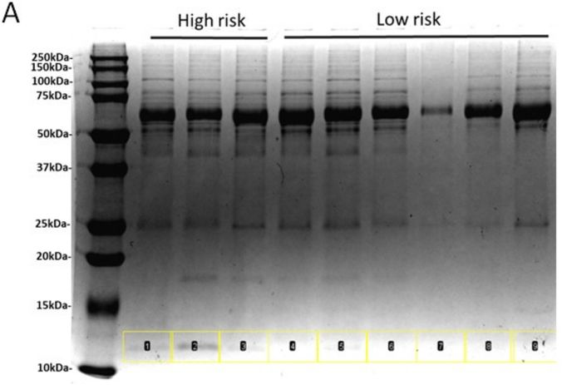
Example on COVID-19 data
The random forest model listed the peaks 5853 and 5905 among the most important peaks for group classification
In the article we validated the possible biomarkers with LC-MS/MS. Which resulted in the identification of Serum Amyloid A1 and A2.

Slide 15
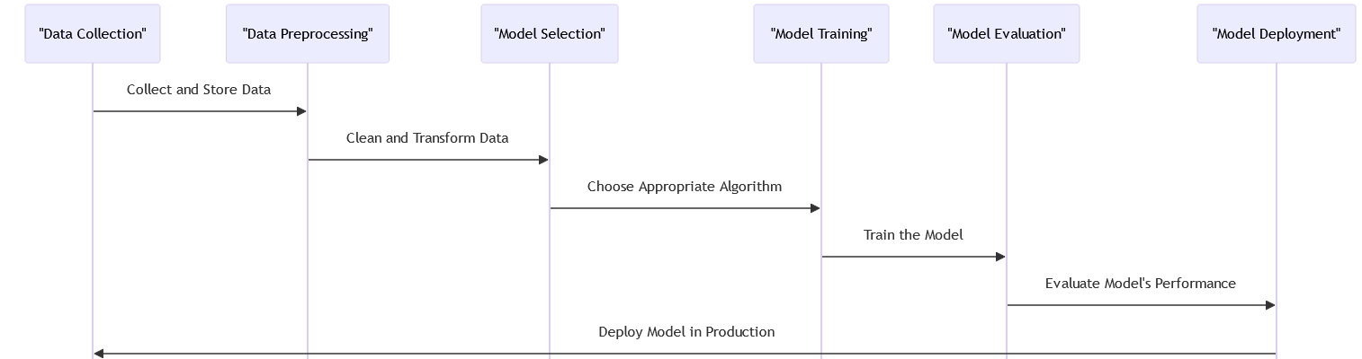
General workflow to work with machine learning

Slide 16
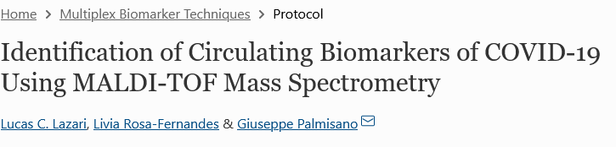
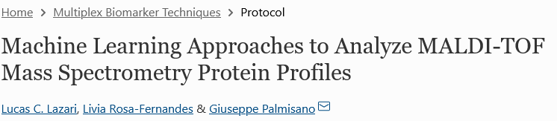
Conclusions
In case you want more in-depth methods:
Machine learning can aid proteomics data processing by searching the most important features (biomarkers);
Machine learning can also serve as a method for diagnosis and prognosis through the training of predictive models;
A lot of data is required, which can be difficult to get depending on the mass spectrometry method you choose;
https://link.springer.com/protocol/10.1007/978-1-0716-2395-4_29
https://link.springer.com/protocol/10.1007/978-1-0716-2395-4_13
In case you don’t want to learn programming to work with mahcine learning, there are softwares to train the models:
Google AutoML, Microsoft Azure Machine Learning Studio, IBM Watson Studio AutoAI, RapidMiner, DataRobot, H2O.ai, Teachable Machine by Google, Turing, Peltarion, MonkeyLearn.

Slide 17
References
FDA-NIH Biomarker Working Group. BEST (Biomarkers, EndpointS, and other Tools) Resource. Silver Spring (MD): Food and Drug Administration (US); Bethesda (MD): National Institutes of Health (US).
1. Prostate-Specific Antigen (PSA): Thompson IM, Pauler DK, Goodman PJ, et al. Prevalence of prostate cancer among men with a prostate-specific antigen level ≤4.0 ng per milliliter. *The New England Journal of Medicine*. 2004;350(22):2239-2246.
2. Troponin: Thygesen K, Alpert JS, Jaffe AS, et al. Fourth universal definition of myocardial infarction (2018). *Journal of the American College of Cardiology*. 2018;72(18):2231-2264.
3. Hemoglobin A1c (HbA1c): American Diabetes Association. 2. Classification and diagnosis of diabetes: standards of medical care in diabetes—2019. *Diabetes Care*. 2019;42(Supplement 1):S13-S28.
4. Alpha-fetoprotein (AFP): Marrero JA, Feng Z, Wang Y, et al. Alpha-fetoprotein, des-gamma carboxyprothrombin, and lectin-bound alpha-fetoprotein in early hepatocellular carcinoma. *Gastroenterology*. 2009;137(1):110-118.
5. B-type natriuretic peptide (BNP) and N-terminal pro b-type natriuretic peptide (NT-proBNP): Januzzi JL, van Kimmenade R, Lainchbury J, et al. NT-proBNP testing for diagnosis and short-term prognosis in acute destabilized heart failure: an international pooled analysis of 1256 patients. *European Heart Journal*. 2006;27(3):330-337.
6. CA-125: Bast RC Jr, Feeney M, Lazarus H, Nadler LM, Colvin RB, Knapp RC. Reactivity of a monoclonal antibody with human ovarian carcinoma. *The Journal of Clinical Investigation*. 1981;68(5):1331-1337.
7. Amyloid beta (Aβ) and Tau proteins: Blennow K, Hampel H. CSF markers for incipient Alzheimer's disease. *The Lancet Neurology*. 2003;2(10):605-613.
8. C-reactive protein (CRP): Ridker PM, Hennekens CH, Buring JE, Rifai N. C-reactive protein and other markers of inflammation in the prediction of cardiovascular disease in women. *The New England Journal of Medicine*. 2000;342(12):836-843.
9. Erythrocyte sedimentation rate (ESR): O'Neill S, Cervera R. Systemic lupus erythematosus. *Best Practice & Research Clinical Rheumatology*. 2010;24(6):841-855.
10. Carcinoembryonic antigen (CEA): Gold P, Freedman SO. Specific carcinoembryonic antigens of the human digestive system. *The Journal of Experimental Medicine*. 1965;122(3):467-481.
Baştanlar, Y., & Özuysal, M. (2014). Introduction to machine learning. miRNomics: MicroRNA biology and computational analysis, 105-128.
Barla, A., Jurman, G., Riccadonna, S., Merler, S., Chierici, M., & Furlanello, C. (2008). Machine learning methods for predictive proteomics. Briefings in bioinformatics, 9(2), 119-128.
Kelchtermans, P., Bittremieux, W., De Grave, K., Degroeve, S., Ramon, J., Laukens, K., ... & Martens, L. (2014). Machine learning applications in proteomics research: How the past can boost the future. Proteomics, 14(4-5), 353-366.
Swan, A. L., Mobasheri, A., Allaway, D., Liddell, S., & Bacardit, J. (2013). Application of machine learning to proteomics data: classification and biomarker identification in postgenomics biology. Omics: a journal of integrative biology, 17(12), 595-610.

